Slide 1
Retrieval based dialogue generation

Slide 2
Hybrid Retrieval-Generation paper：
2018
Delete, retrieve, generate: a simple approach to sen- timent and style transfer. | NAACL2018
Retrieve and refine: Improved sequence generation models for dialogue. | ARXIV2018
Exemplar encoder- decoder for neural conversation generation | acl2018
A knowledge-grounded neural conversation model | AAAI2018
An ensemble of retrieval- based and generation-based human-computer conversation systems | IJCAI2018
2019
A Hybrid Retrieval-Generation Neural Conversation Model | CIKM2019
Response generation by context-aware prototype editing | AAAI2019
EnsembleGAN: Adversarial learning for retrieval-generation ensemble model on short-text conversation | SIGIR2019
Retrieval-enhanced adversarial training for neural response generation. | ACL2019
Skeleton- to-response: Dialogue generation guided by retrieval memory | NAACL2019
Retrieval_guided dialogue response generation via a matching_to-generation framework. | EMNLP2019
Retrieval-based Goal-Oriented Dialogue Generation | 2019 arvix
2018
2019
2020
Exemplar Guided Neural Dialogue Generation. | IJCAI2020
Retrieval-Polished Response Generation for Chatbot | IEEE期刊2020
An Ensemble of Generation- and Retrieval-Based Image Captioning With Dual Generator Generative Adversarial Network | IEEE期刊？2020
Prototype-to-Style: Dialogue Generation with Style-Aware Editing on Retrieval Memory | 2020 arxiv
Hybrid Generative-Retrieval Transformers for Dialogue Domain Adaptation | DSTC8@AAAI 2020
Controlling Dialogue Generation with Semantic Exemplars | 2020 arxiv
A Hybrid Chinese Conversation model based on retrieval and generation | 2021期刊
2020

Slide 3
三篇文章框架对比
文章 | 检索方式、排序方式 | 二次排序 | 使用的检索结果 | 生成主结构 | 生成结合检索方式 | 最终答案选取
An Ensemble of Retrieval-Based and Generation-Based Human-Computer Conversation Systems IJCAI2018 | inverted indexes tf-idf | 无 | exemplar response | encoder-decoder | 句向量拼接+ attention+ copy机制 multi-seq2seq | 检索结果+生成结果 rerank（GBDT）
Skeleton-to-response: Dialogue generation guided by retrieval memory NAACL2019 | Lucene 前30 | Jaccard | Skeleton | encoder + decoder | gate | 生成的答案
Exemplar Guided Neural Dialogue Generation IJCAI2020 | BM25 | Latent Topic Inference. | exemplar response | encoder + decoder | gate | 生成的答案

Slide 4

An Ensemble of Retrieval-Based and Generation-Based Human-Computer Conversation Systems IJCAI2018
Yiping Song, Cheng-Te Li, Jian-Yun Nie, Ming Zhang, Dongyan Zhao, Rui Yan
北大 台湾成功大学 蒙特利尔大学

Slide 5
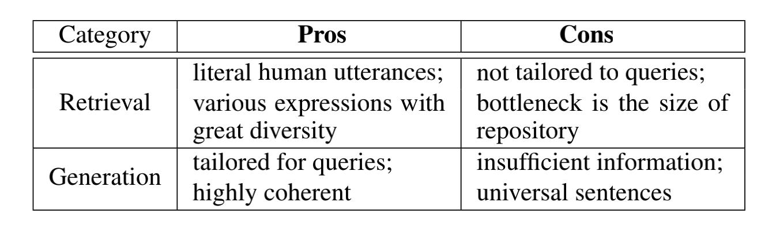
An Ensemble of Retrieval-Based and Generation-Based Human-Computer Conversation Systems IJCAI2018
动机：
当前的对话模型主要分为两种： retrieval-based and generation-based.
Both ways have certain advantages but suffer from their own disadvantages.
propose an ensemble of retrieval_based and generation-based conversation systems.
Notes:
the retrieval-based conversation systems search a corresponding utterance (called a reply) that best matches the query in a pre-constructed conversational repository.

Slide 6
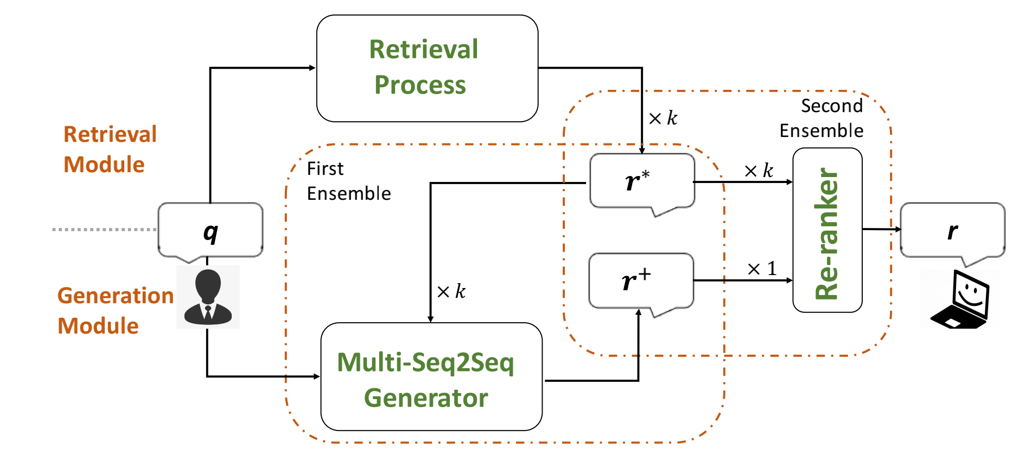
An Ensemble of Retrieval-Based and Generation-Based Human-Computer Conversation Systems IJCAI2018
module | 功能
retrieval | search for k candidate replies。
integration | integrate retrieved replies into the Seq2Seq generation process.
generation | generate a reply via the multi-seq2seq generator based on the query and k retrieved replies.
re-ranker | re-evaluate the retrieved replies and the newly generated reply so that more meaningful replies with abundant information would stand out.
怎么做：

Slide 7
An Ensemble of Retrieval-Based and Generation-Based Human-Computer Conversation Systems IJCAI2018
retrieval
source：collect huge amounts of conversational corpora from on-line chatting platforms
retrieval process： off-line、 inverted indexes、 Lucene
检索系统提供多个答案，并根据语义匹配程度对其进行评分。我们保留top-k答复以供进一步处理。
query q
extract keywords
get tf-idf as retrieval schema
associated r∗ of q∗ will be returned as the output
search the most relevant q∗ in database.
<q,r*>
Notes:
When a query q is issued, keywords extracted from q and their tf.idf values are formulated as the retrieval schema and feed into the retrieval system to search the most relevant q∗ in database.

Slide 8
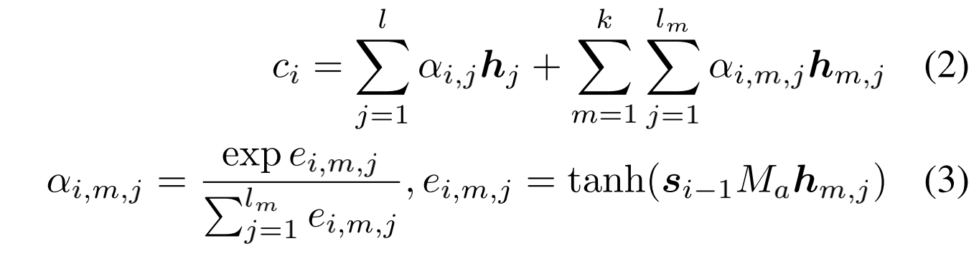
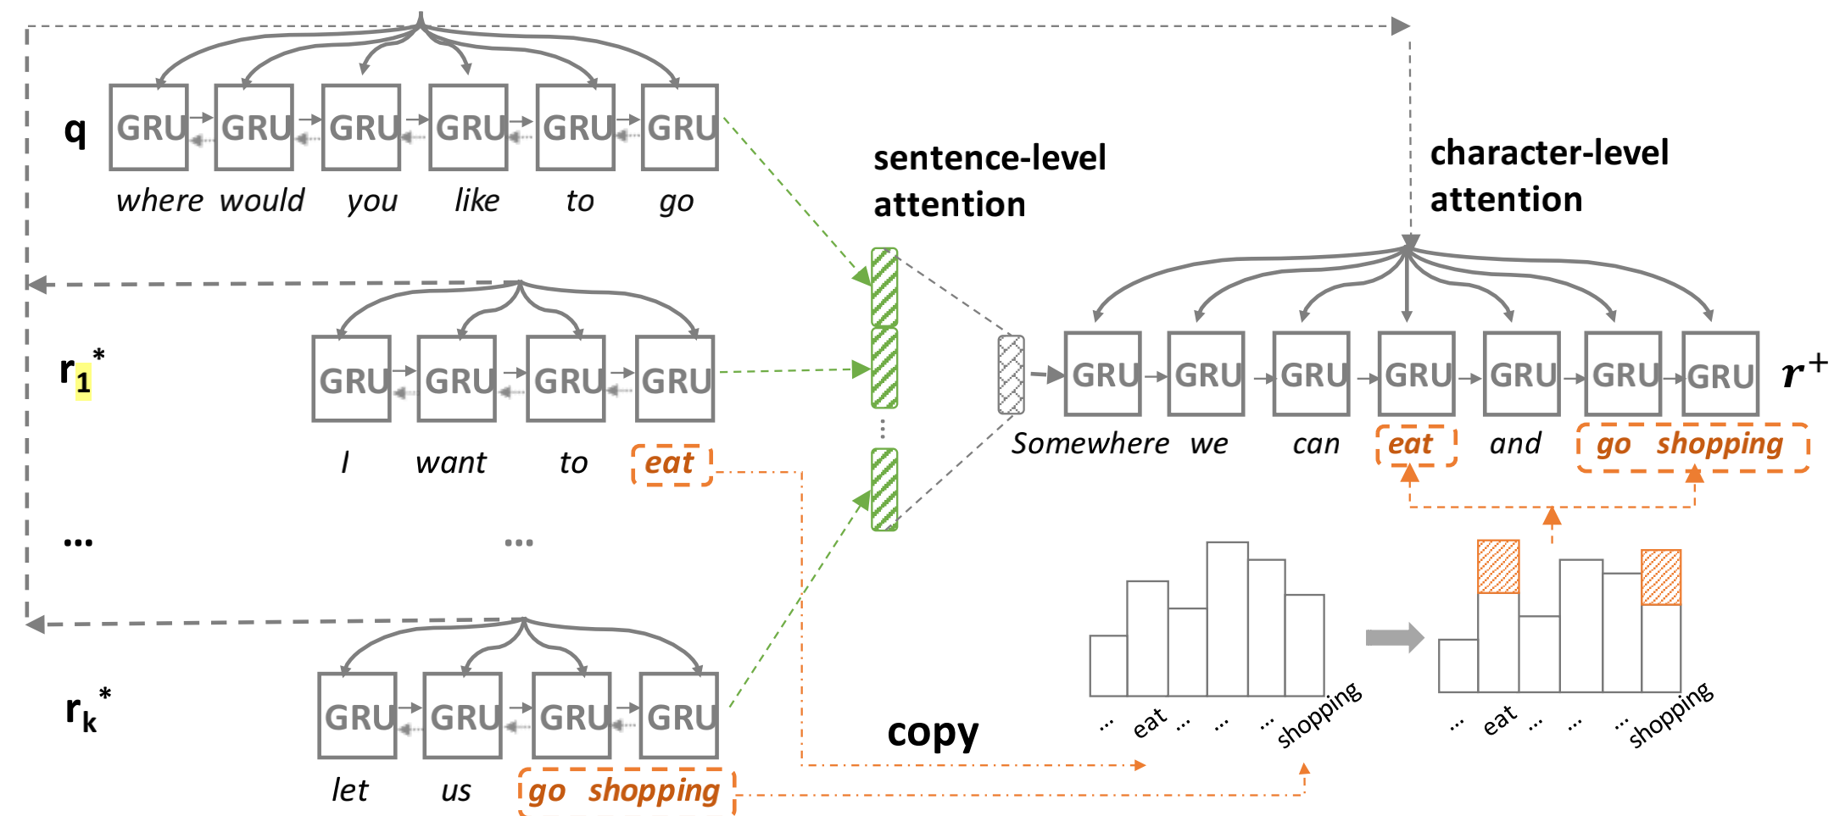
An Ensemble of Retrieval-Based and Generation-Based Human-Computer Conversation Systems IJCAI2018
integration：Two-level attention + copy
Two-level | 作用
sentence-level | assign different importance of each retrieved replies
character-level | measure different importance to each word in retrieved replies
linear
Notes:
角标 j : query 或者r*中的第j个词。 i：decoder 的第i个时刻。m，检索到的第m句话

Slide 9
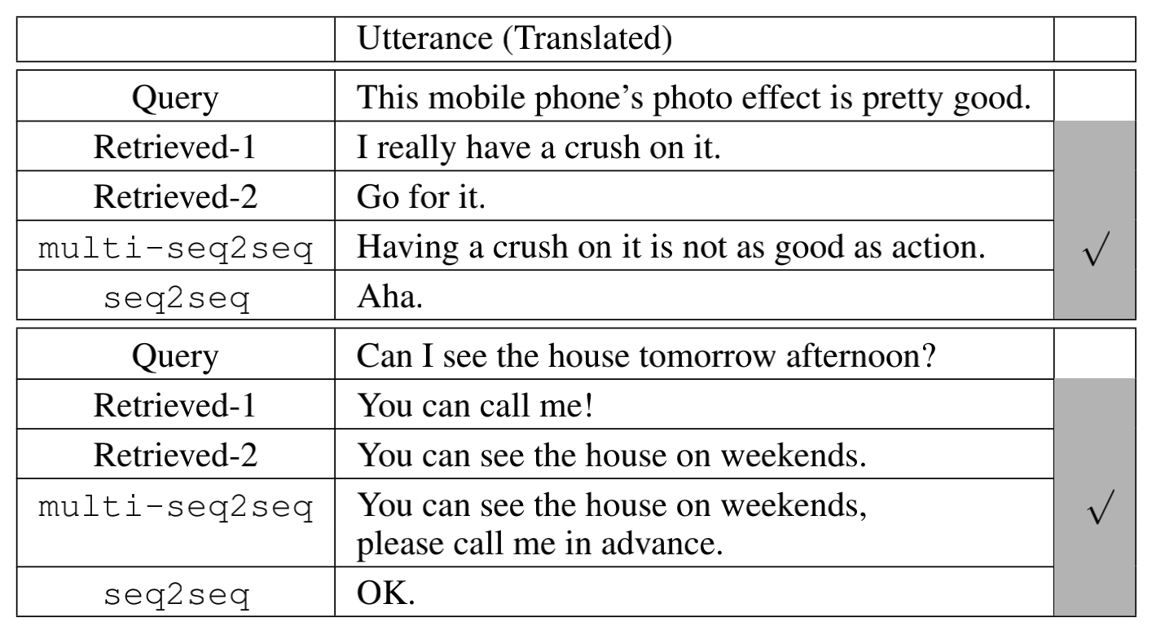
An Ensemble of Retrieval-Based and Generation-Based Human-Computer Conversation Systems IJCAI2018
最后一步Re-ranker：
Gradient Boosting Decision Tree (GBDT)
Term similarity.Entity similarity.Topic similarity.Statistical Machine Translation.Length.Fluency.
Case study:

Slide 10
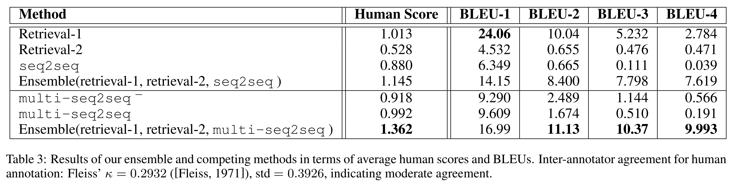
An Ensemble of Retrieval-Based and Generation-Based Human-Computer Conversation Systems IJCAI2018
数据集： Sina Weibo and Baidu Tieba
Notes:
multi-seq2seq- Generation component, which only applies two-level attention strategies.
• multi-seq2seq . Generation component, which ap_x0002_plies two-level attention and copy strategy.

Slide 11

Skeleton-to-response: Dialogue generation guided by retrieval memory NAACL2019
Deng Cai 、Yan Wang、Victoria Bi、Zhaopeng Tu、Xiaojiang Liu、Wai Lam、Shuming Shi
机构：香港中文、Tencent AI Lab、

Slide 12
Skeleton-to-response: Dialogue generation guided by retrieval memory NAACL2019
动机：
1、类似上文
2、出现问题：
原因：both useful and useless information is mixed in the dense vector space, which is uninterpretable and uncontrollable.
现象1：IR-guided models are inclined to degenerate into a copy mechanism, in which the generative models simply repeat the retrieved response without necessary modifications.
现象2：Sharp performance drop is caused when the retrieved response is irrelevant to the input query.
3、解决思路：
1、The guidance from IR results should only specify a response aspect or pattern, but leave the query-specific details to be elaborated by the generative model itself;
2、The retrieval results typically contain excessive information, such as inappropriate words or entities. It is necessary to filter out irrelevant words and derive a useful skeleton before use.

Slide 13
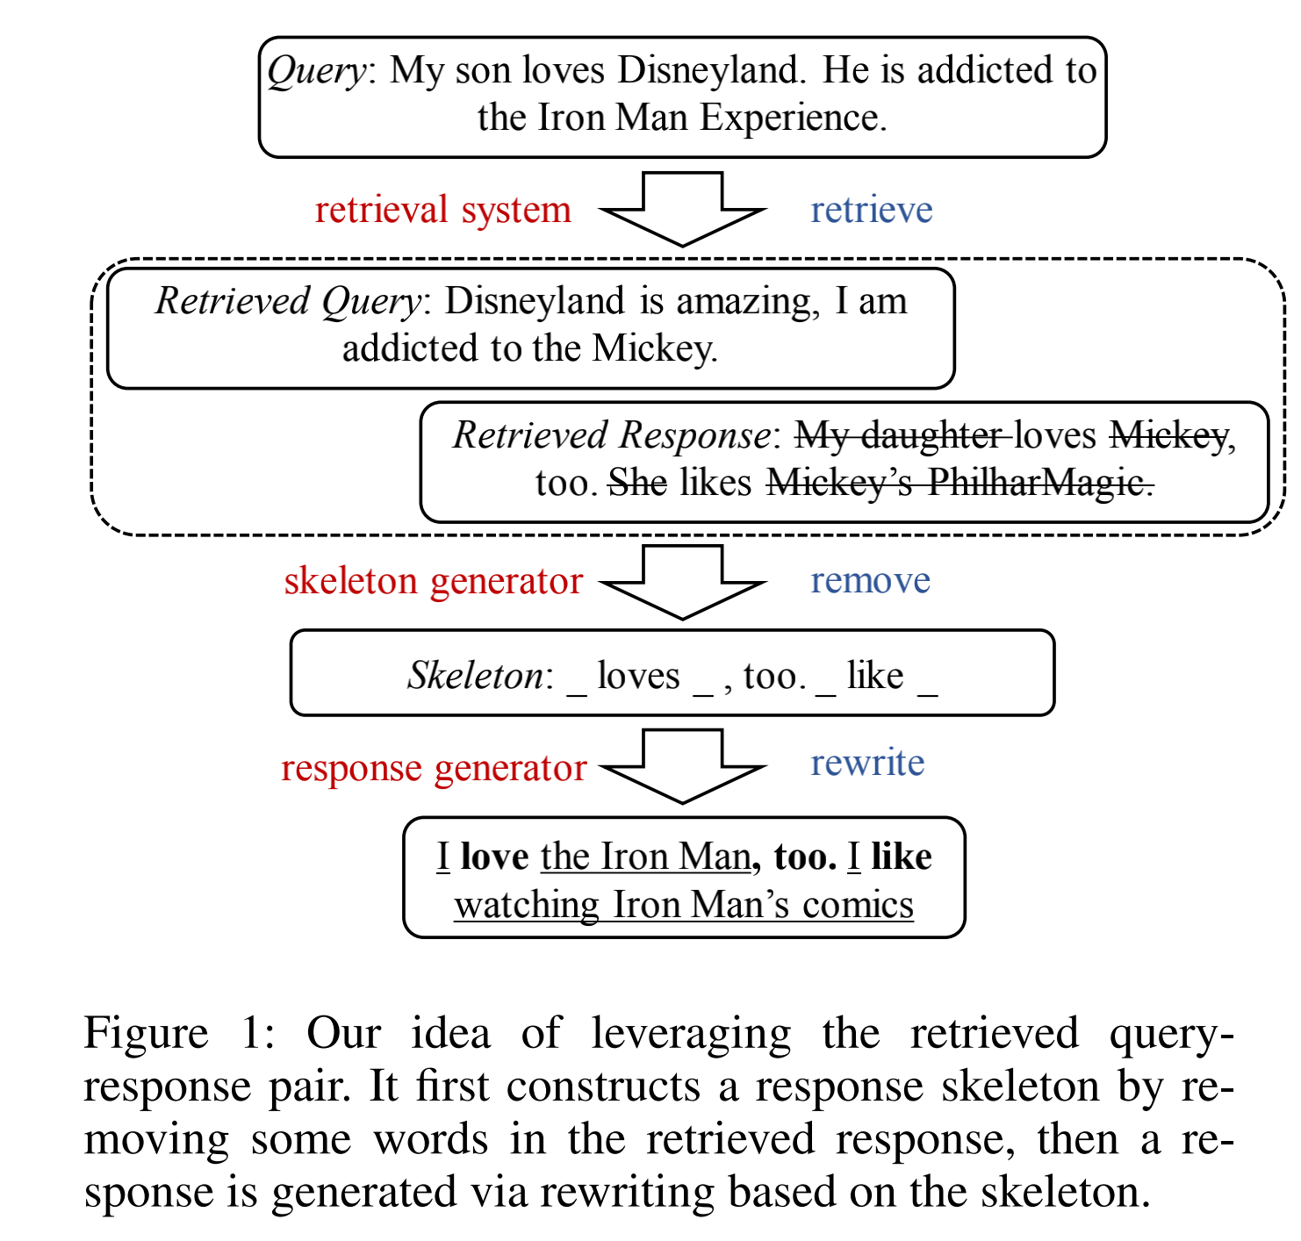
Skeleton-to-response: Dialogue generation guided by retrieval memory NAACL2019
模型设计：
模块 | 功能
skeleton generator | extracts a response skeleton by detecting and removing unwanted words in a retrieved response
response generator | adding query-specific details to the generated skeleton for query-to-response generation.
技术 | 解决不可微
policy gradient | rewarding the output of the skeleton generator based on the feedback from a pre-trained critic.
multi-task learning | solve both the skeleton generation and the response generation

Slide 14
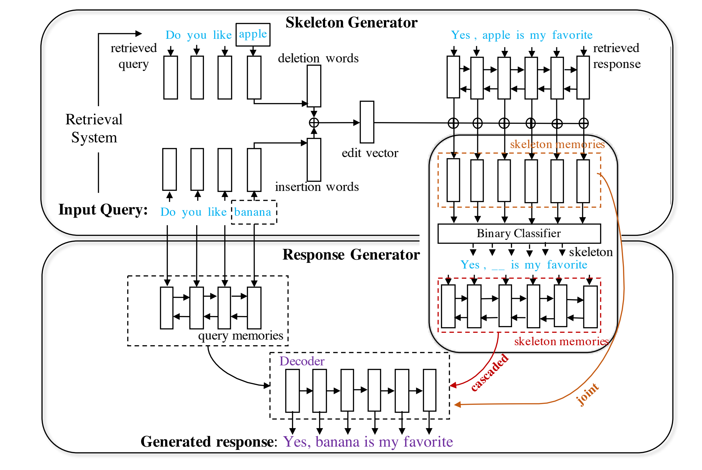
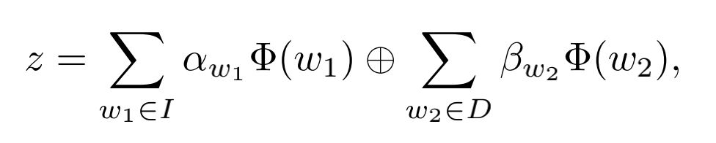
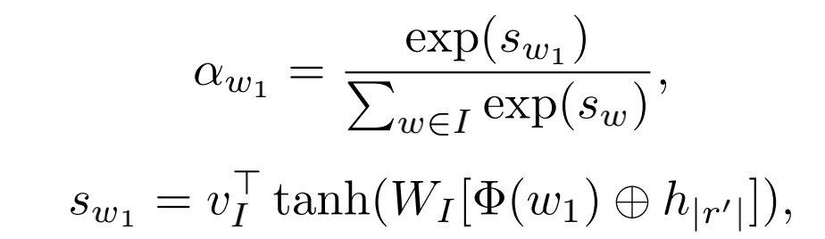
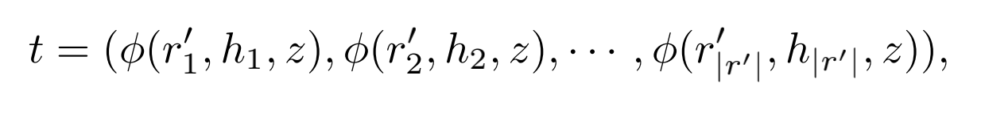
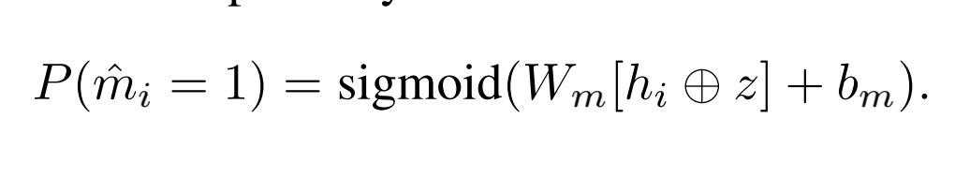
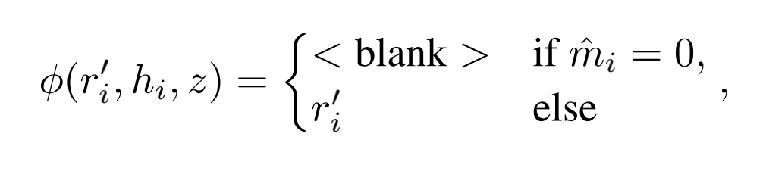
Skeleton-to-response: Dialogue generation guided by retrieval memory NAACL2019
Notes:
sigmoid = 0 ？
强化学习？？最后是分别分段学习吗？

Slide 15
skeleton generator
事先准备好：
insertion words I deletion words D
w1∈I
w2∈D
Notes:
The insertion words include words that are in the original query q, but not in the retrieved query q0 , while the deletion words do the opposite.

Slide 16


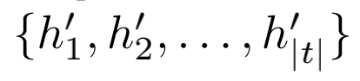
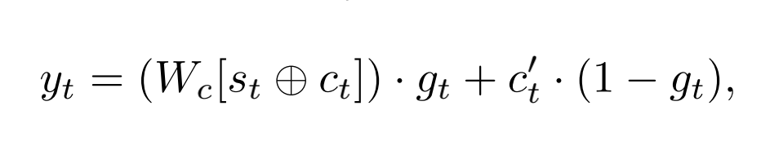
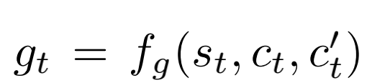
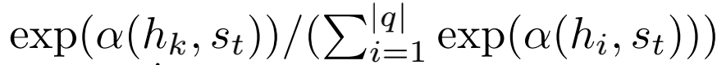
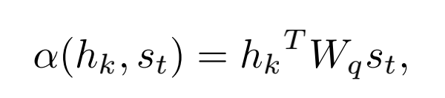
response generator
Ct是hk的加权求和，权重计算方式如下：
Notes:
biLSTM

Slide 17
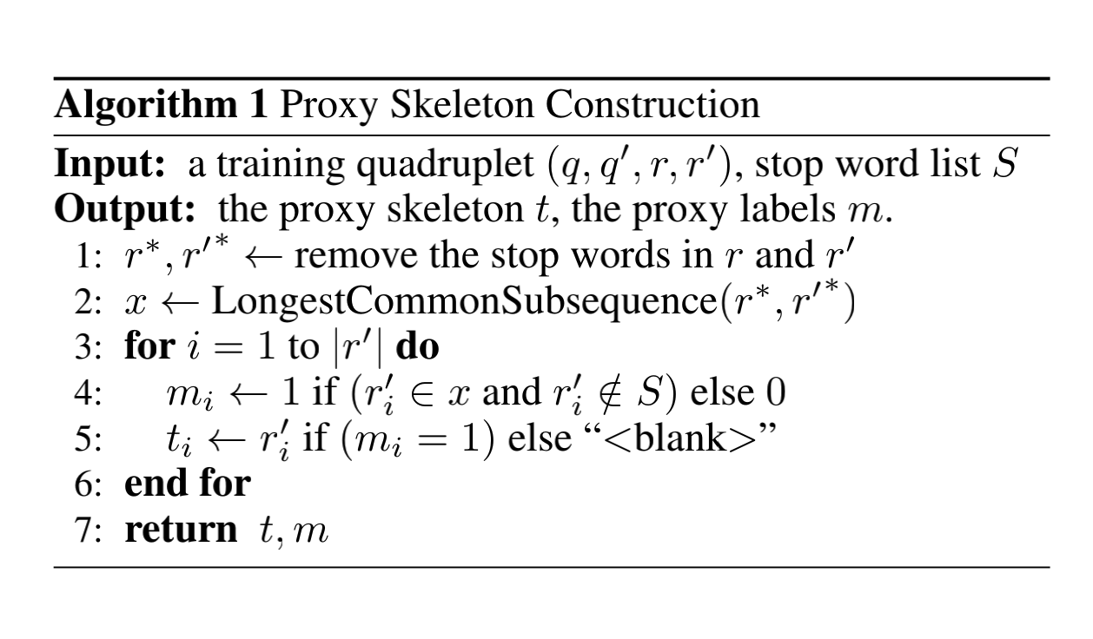
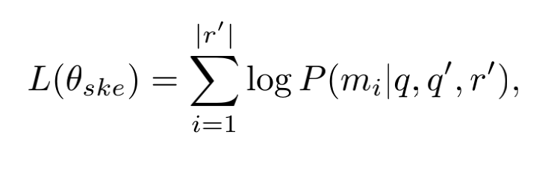
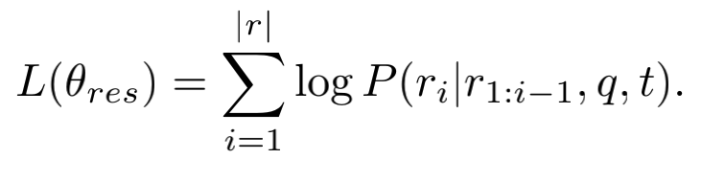
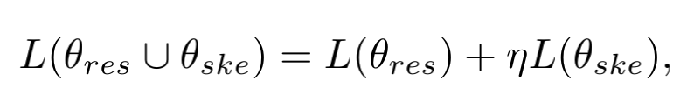
Skeleton-to-response: Dialogue generation guided by retrieval memory NAACL2019
解决不可微的两种方式：1、joint

Slide 18
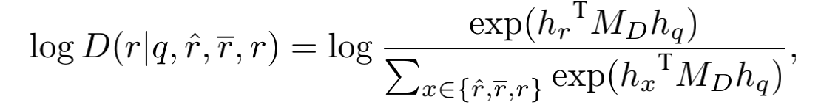
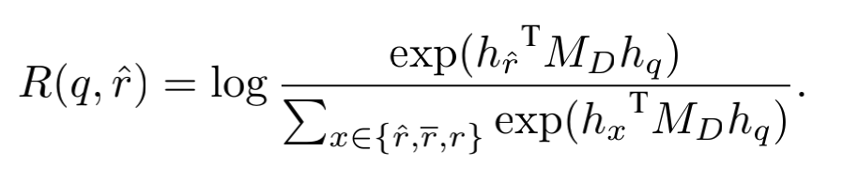
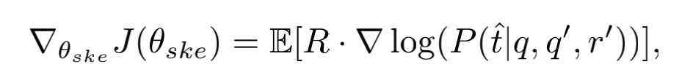
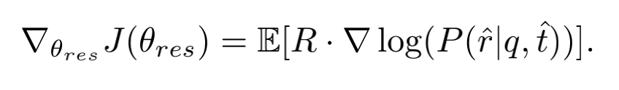
Skeleton-to-response: Dialogue generation guided by retrieval memory NAACL2019
解决不可微的两种方式：2、RL
设计一个判别器：
输入：q,a human-written response r, a machine-generated response rˆ, and a random response r.
输出：
Notes:
hx is a vector representation of x, produced by a bidi_x0002_rectional LSTM (the last hidden state)
为什么还不可微。

Slide 19
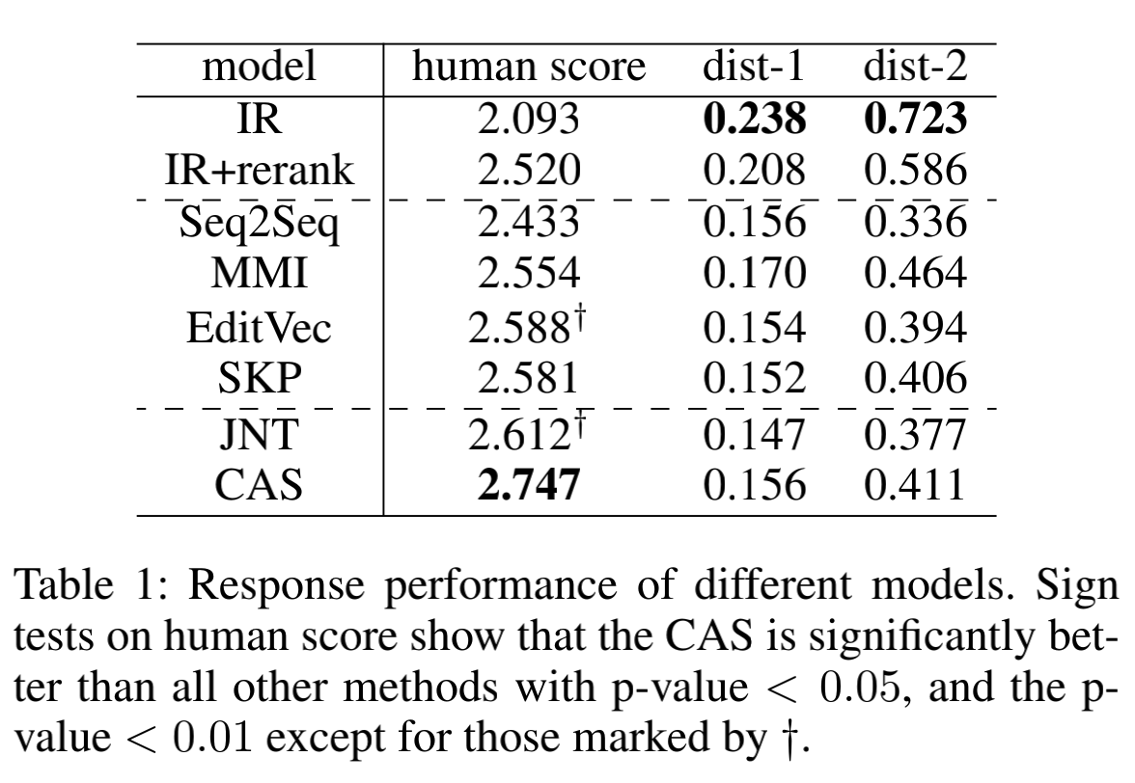
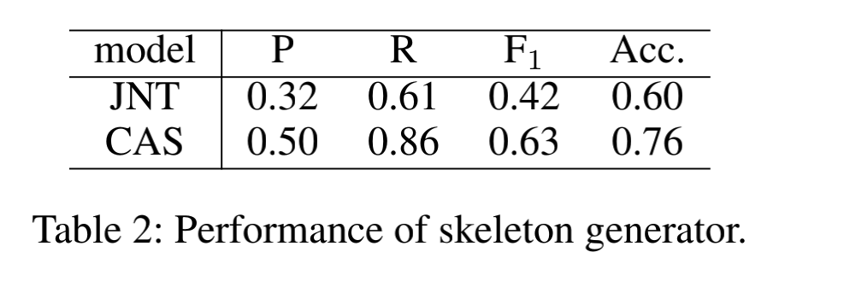
Skeleton-to-response: Dialogue generation guided by retrieval memory NAACL2019
数据集： Douban
Notes:
We use JNT to denote our model with joint integra_x0002_tion, and CAS for our model with cascaded integration， We design a response generator that takes an intact retrieval response as its skeleton input (i.e., to completely skip the skeleton gen_x0002_eration step), denoted by SKP.7

Slide 20

Exemplar Guided Neural Dialogue Generation IJCAI2020
Hengyi Cai， Hongshen Chen , Yonghao Song , Xiaofang Zhao1 and Dawei Yin
单位：计算所、国科大、Data Science Lab, JD，Baidu Inc.

Slide 21
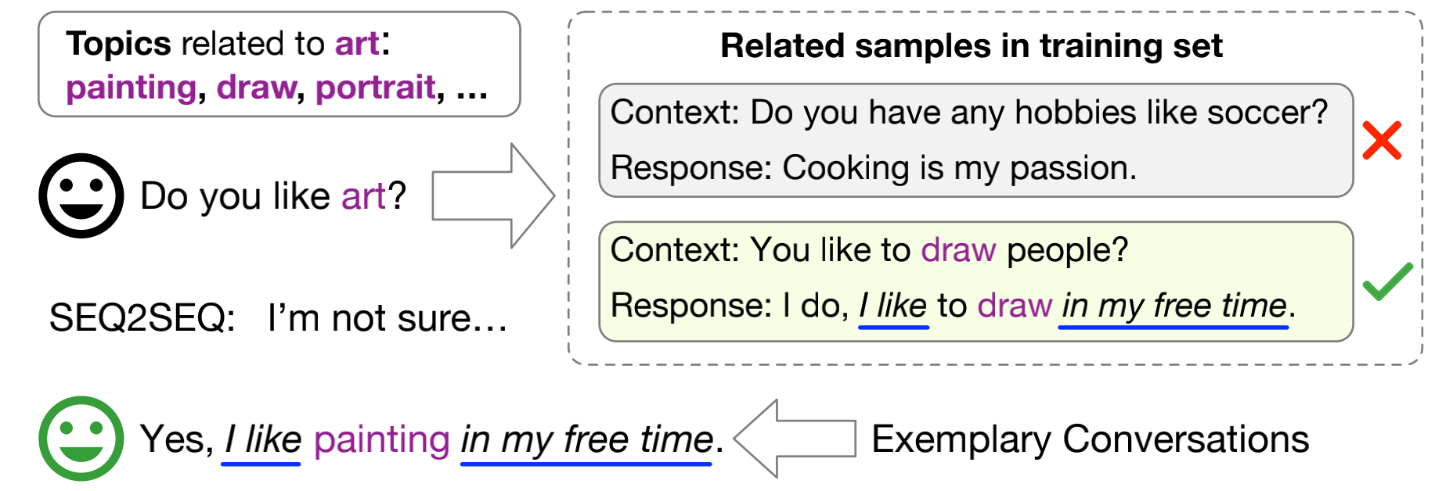
Exemplar Guided Neural Dialogue Generation IJCAI2020
动机
capturing all information required to generate responses barely by the model parameters is not necessarily adequate.
related examples from the training data provide exemplary information.
Noisy exemplars impair the neural dialogue models understanding the conversation topics and even corrupt the response generation.
useful exemplars are required to be not only literally-similar, but also topic-related with the given context.

Slide 22
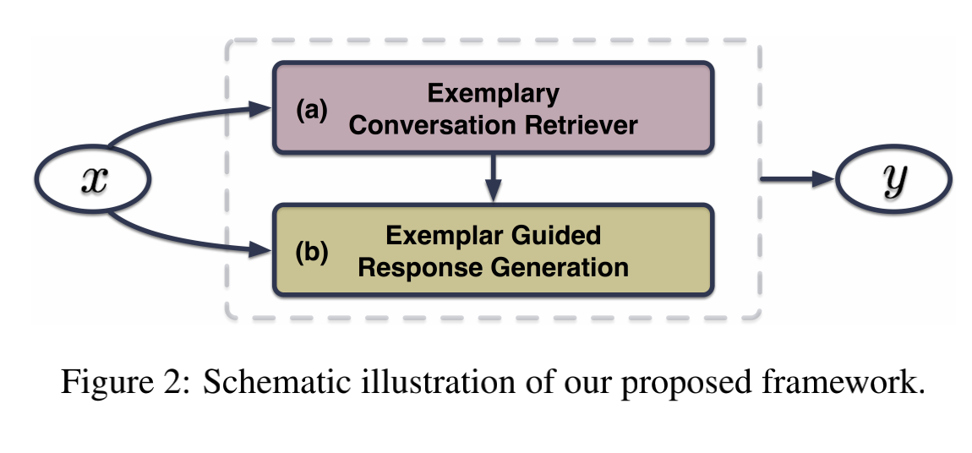
Exemplar Guided Neural Dialogue Generation IJCAI2020
模型设计：
模型部分 | 方式 | 功能
two-stage exemplar retrieval | first stage （BM25） | a small subset of conversations is retrieved from a training set given a dialogue context.
 | second stage （MLP） | These candidate exemplars are then finely ranked regarding the topical proximity to choose the best-matched exemplar response.
decoding | multi-source sampling | response word can be drawn from the vocab_x0002_ulary embedding space and exemplary collections.
 | two kinds of exemplary | The exemplar response is utilized as a soft response template, which can be viewed as local exemplary signals, whereas the dialogue topics serve as global exemplary semantics.

Slide 23
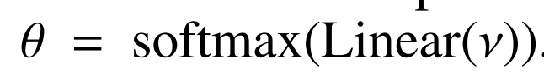
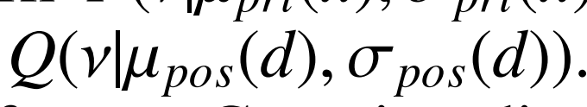

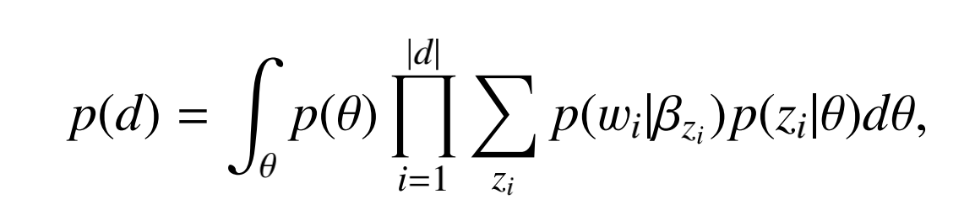
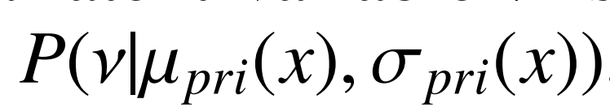
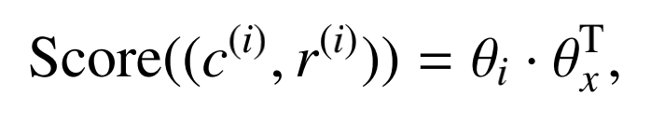
Exemplar Guided Neural Dialogue Generation IJCAI2020
Exemplary Conversation Retriever
First-round Exemplar Retrieval ：BM25
Latent Topic Inference(second round)：
训练网络阶段：
排序阶段（Exemplar Response Refining）：
Miao et al.
[2017]
reparameterization trick
topic distribution θ
d = (x,y)
Notes:
z ∈ RM×H as the topic word embeddings, Λ ∈ RK×H as the topic embeddings，βk = softmax(z · Λk)

Slide 24
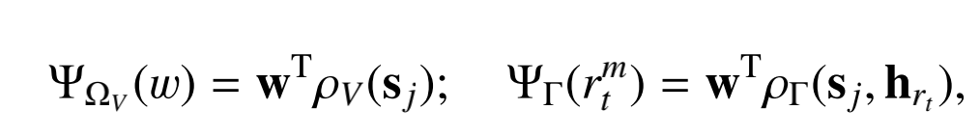
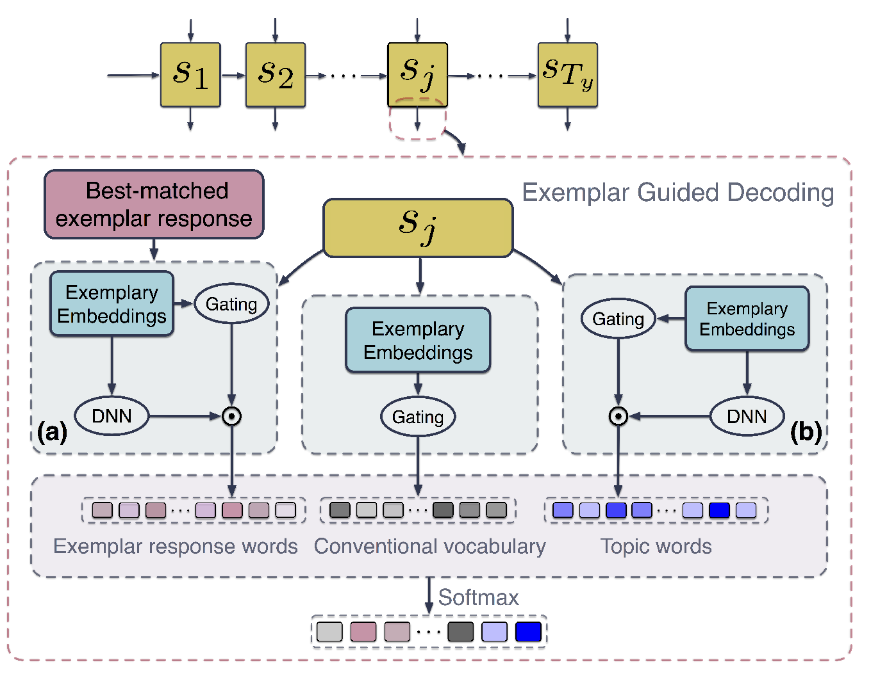
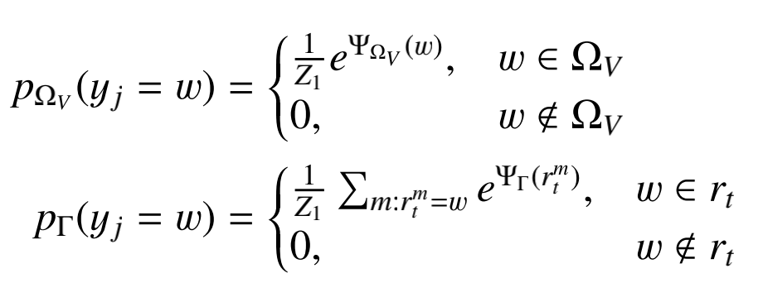
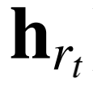
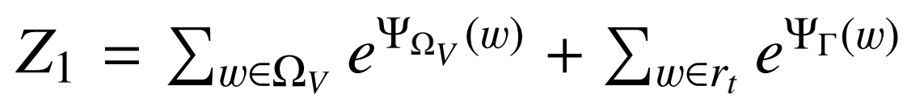
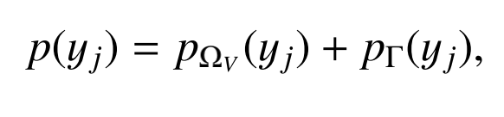
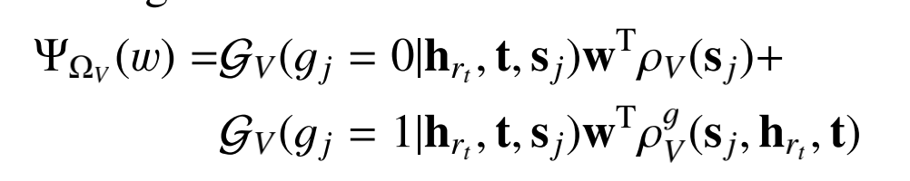
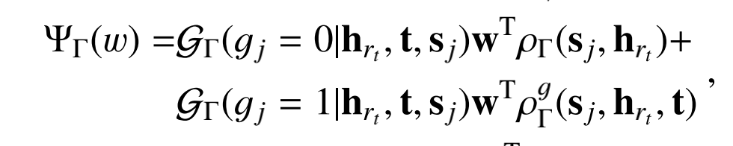
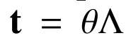
Exemplar Guided Neural Dialogue Generation IJCAI2020
Decoding with Exemplar Response：
ps: exemplary embeddings :consist of the exemplar response rt and the topic embedding t
Notes:
where ρV and ρ are non-linear transformation functions, like multi-layer perceptrons, w is a one-hot indicator vector of word w， Λ ∈ RK×H as the topic embeddings

Slide 25
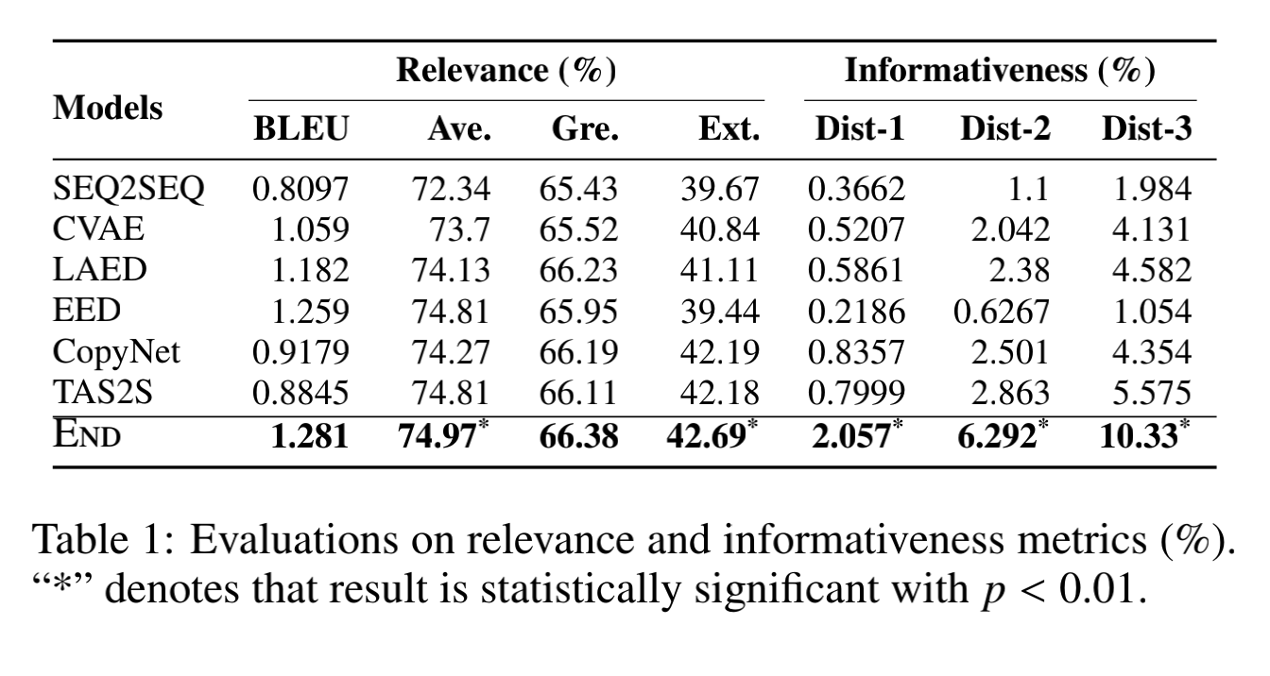
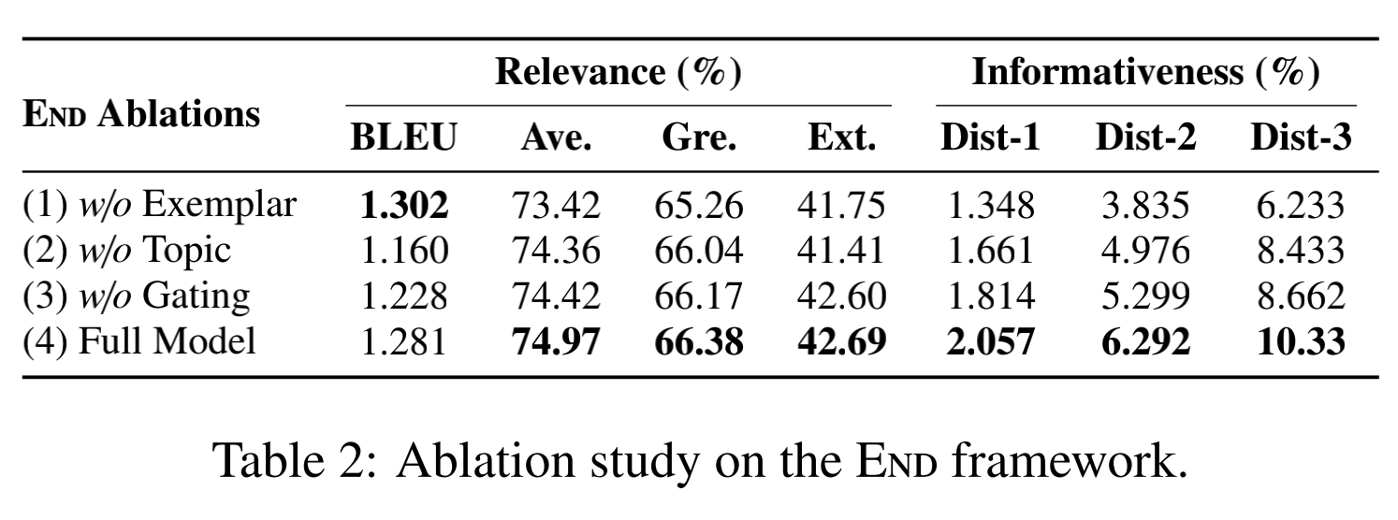

Slide 26
常见用词
guided enhanced oriented aware grounded
2020 的趋势：
生成模型使用transformer 或bert类
模糊知识和句子的边界（从对话数据外部引入一句话）

